Slide 1
Advanced Hotel Booking Analysis

Slide 2
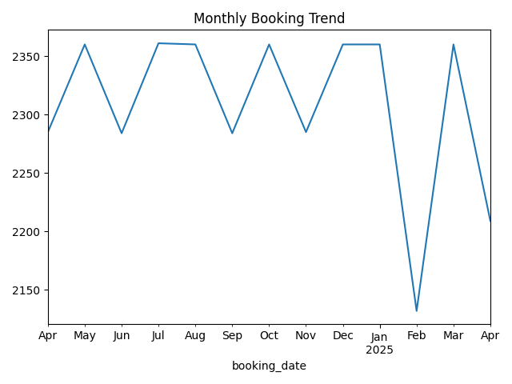
Monthly Booking Trend

Slide 3
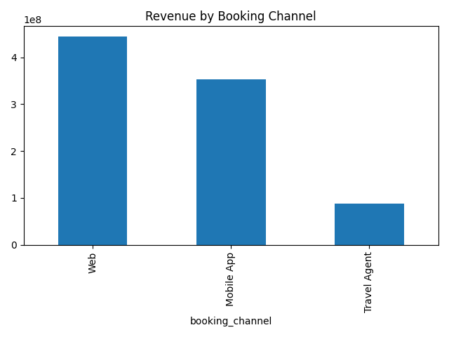
Revenue by Channel

Slide 4
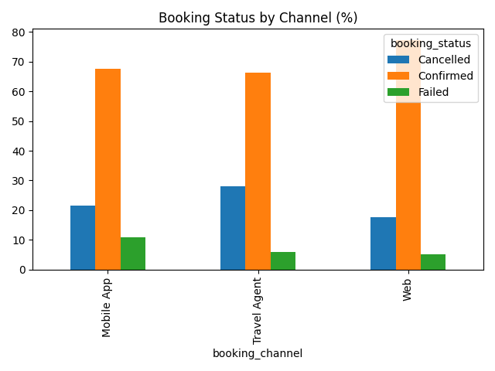
Cancellation Analysis

